Slide 1
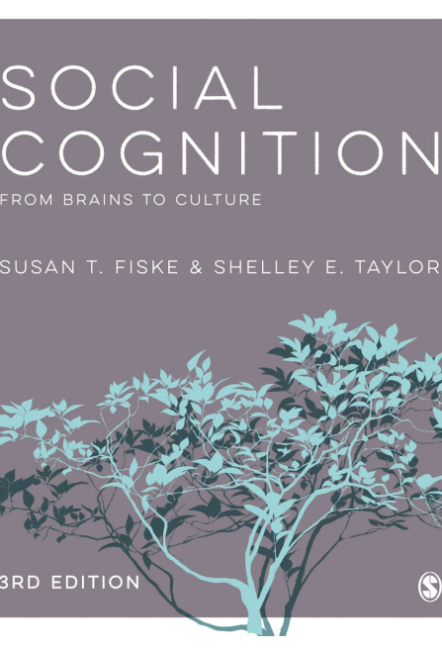
Dual Modes in Social Cognition
Gao Fei

Slide 2
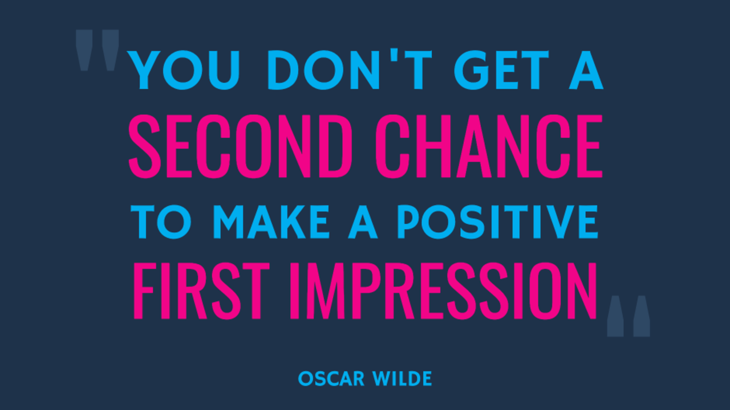


Slide 3
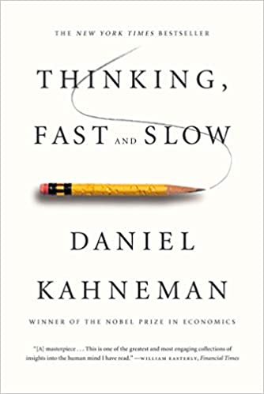
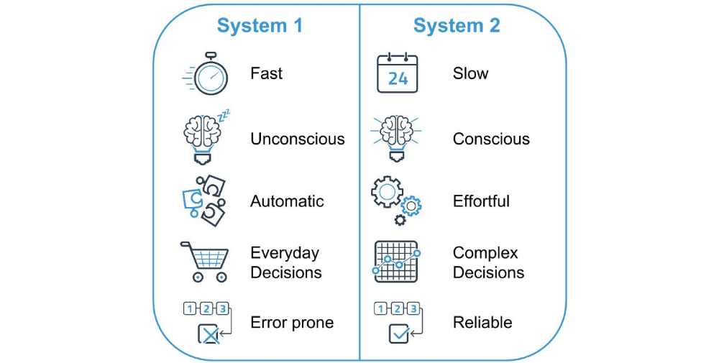
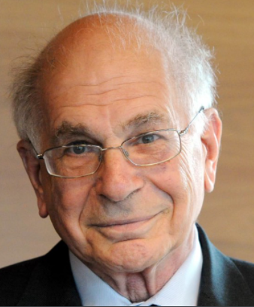

Slide 4
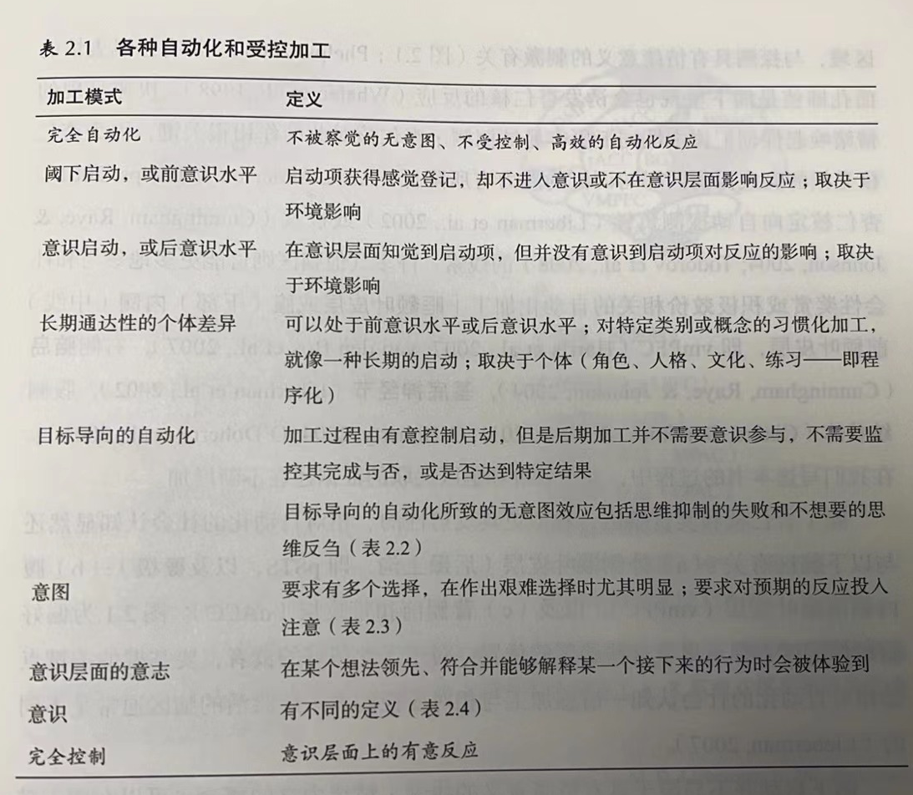


Slide 5
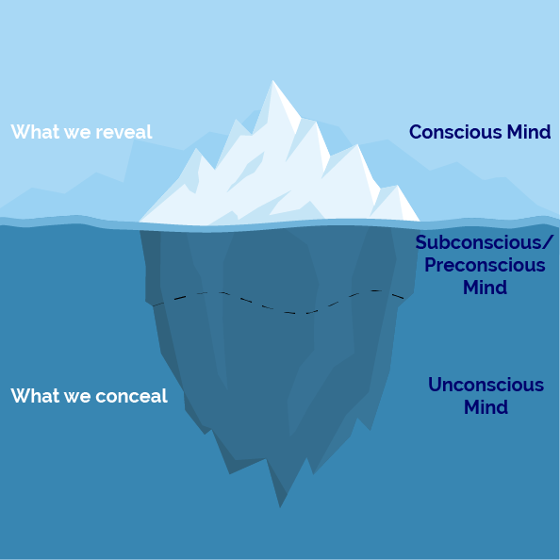
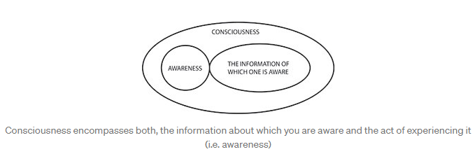
Terminology
consciousness (意识) vs. awareness (觉察）
notice vs. attention vs. awareness?
Intent vs. goal vs. motive?

Slide 6
mindlessness

Slide 7
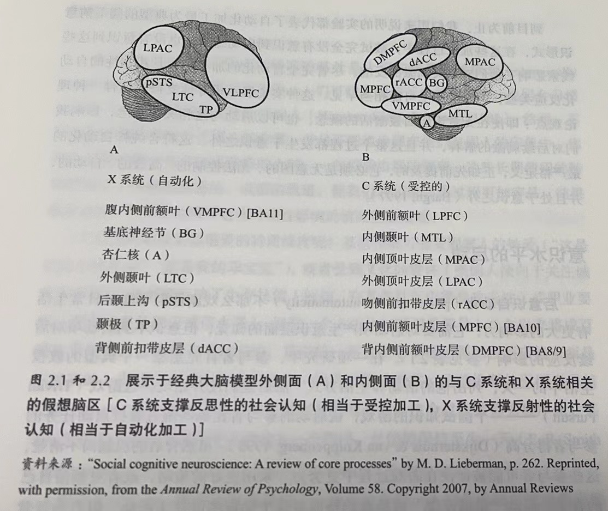
Subliminal priming
Subliminal priming occurs when a concept is activated by the environment, but at exposure times below conscious awareness.
The neural mechanisms of immediate emotional priming.
The techniques used for measuring subliminal priming
Notes:
面孔启动

Slide 8
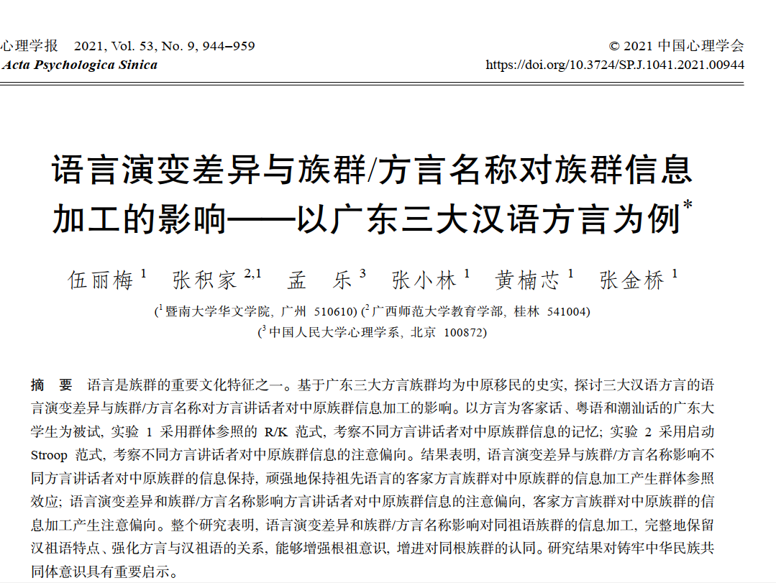
Subliminal priming
Subliminal priming can affect behavior.
Subliminal exposure to different race faces and subsequent provocation.
冬奥会

Slide 10
Conscious/postconscious Priming
Less dramatic but probably more impactful on a daily basis, postconscious automaticity entails conscious perception of the prime but no awareness of its effects on subsequent reactions
Bargh et al. (1996): “elderly”.

Slide 11
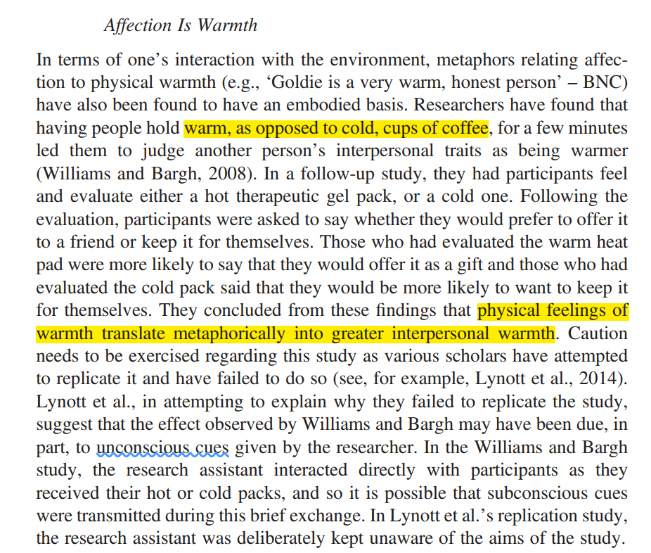
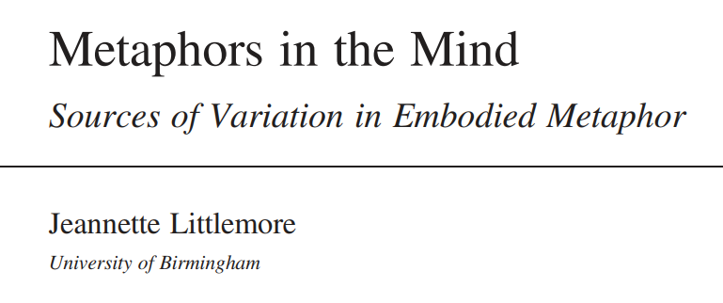

Slide 13
Chronic Accessibility
Somewhere around preconscious and postconscious automaticity are individual differences in chronically accessible concepts.
People may or may not be aware that they habitually code other people in terms of, say, their friendliness, intelligence, or independence.
Proceduralization, practice effects / statistical learning
Intelligence vs. People skills
Proceduralization/ automaticity (native-ness) in language learning
My thought: This proceduralization implicates an error-based learning process as well?

Slide 14

Sheer
Efficiency

Slide 15
Goal-Driven Automatic Processes
Goal-dependent automaticity is automatic according to some of the criteria, such as lack of awareness of the process itself, not needing to monitor the process to completion, and lack of intending all the specific outcomes.
Someone asks about your dissertation in a party

Slide 16
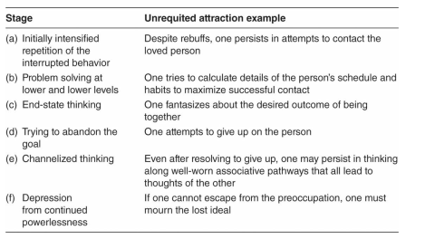

Goal-Driven Automatic Processes
Goal-Inconsistent Automaticity
Sometimes people’s goals trigger automatic thoughts consistent with their conscious preferences, but people can’t always think what they want, even if they try.
Rumination
Takeaway message: How to deal with 失眠/失恋。

Slide 18
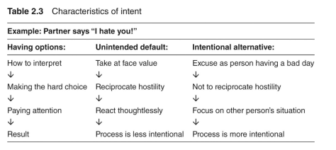
Intent
Having moved through preconscious, postconscious, chronic, and goal dependent automaticity, as well as unintended consequences of automaticity, we land on intent, a crucial feature of control.
People implement their intended way of thinking by paying attention
Manslaughter vs. murder

Slide 20
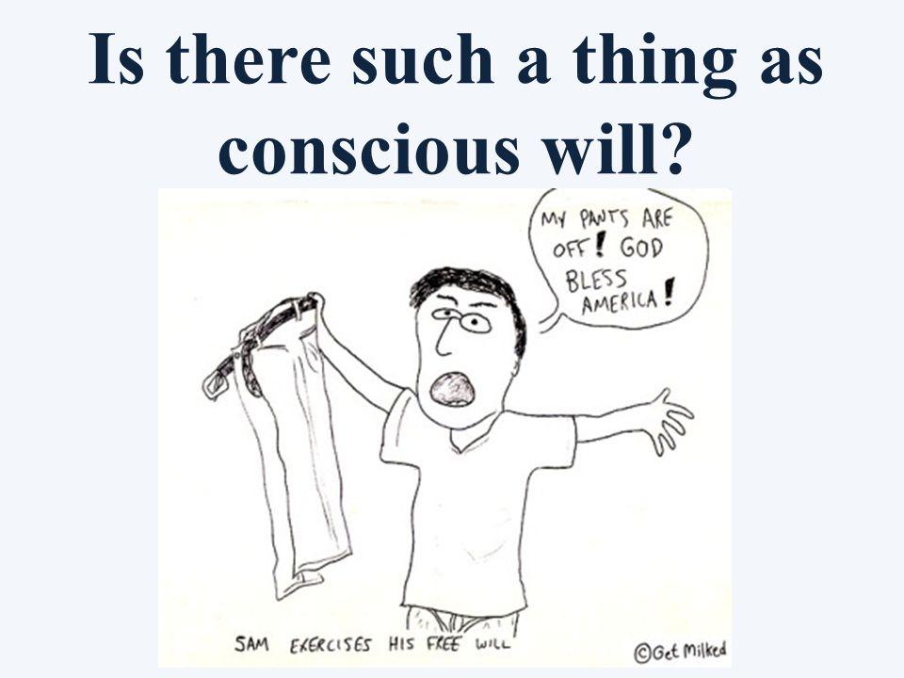
Conscious Will
Conscious will is an illusion created by people thinking about an action before performing it (Wegner, 2003)
In the extreme, people think they can control even other people’s outcomes and behavior.
冬奥会

Slide 22
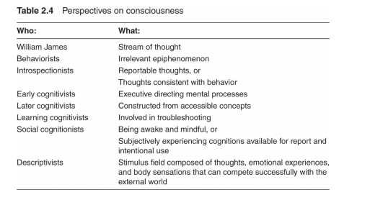
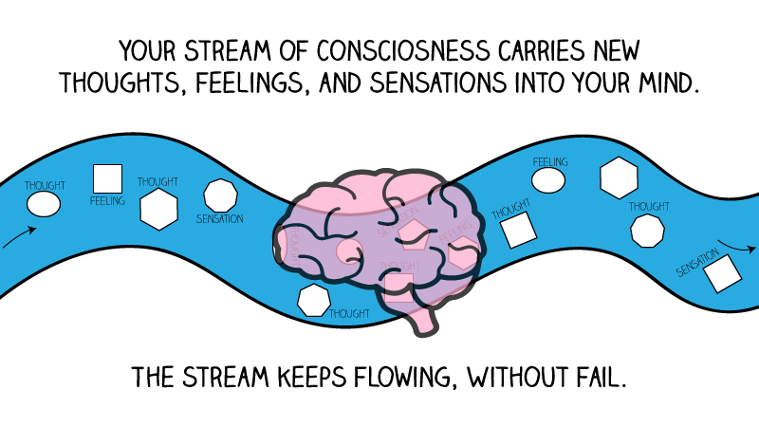
Consciousness
William James (1890/1983) described consciousness eloquently as the stream of thought.

Slide 23
Consciousness
Social-personality psychologists have focused on the contents of consciousness just for its own sake.
They describe ongoing consciousness as the stimulus field composed of thoughts, emotional experiences, and body sensations (i.e., daydreaming) that can compete successfully with the external world.
Kinds of Thought
stimulus dependent (focused on the current environment) vs. stimulus independent (mind-wandering) operant thought (instrumental, problem solving) vs. respondent thought processes (ordinary distractions, unbidden images)

Slide 24
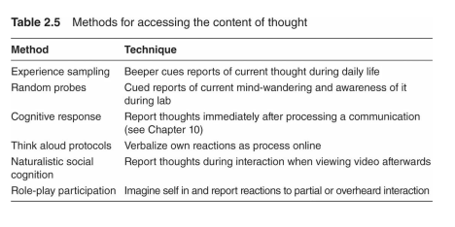
Consciousness
Sampling People’s Thoughts
An enduring challenge: validity of thought sampling

Slide 25
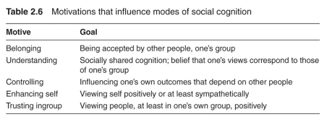
Motivations Influence Which Modes Operate

Slide 26
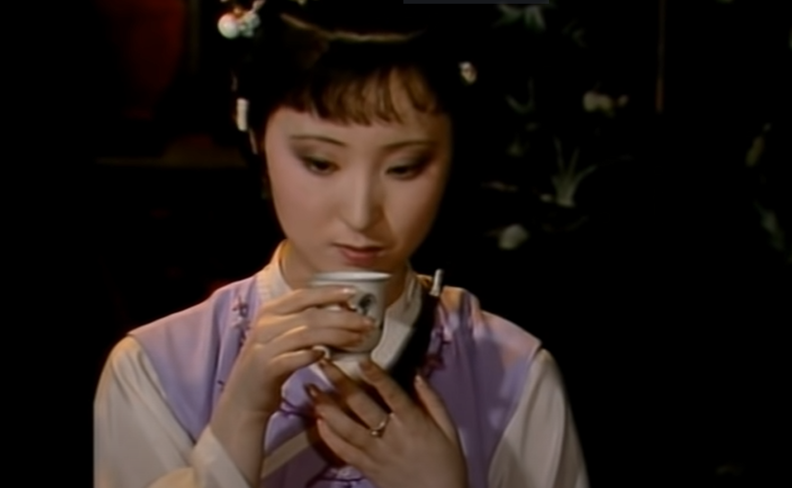
Motivations Influence Which Modes Operate
Belonging, social isolation
Embodiment: The neural signature of social pain mimics the neural signature of physical pain in that both activate the anterior cingulate cortex.
The social motive that most obviously drives social cognition is understanding, the need for socially shared cognition.
Learning -> understanding -> automaticity

Slide 27
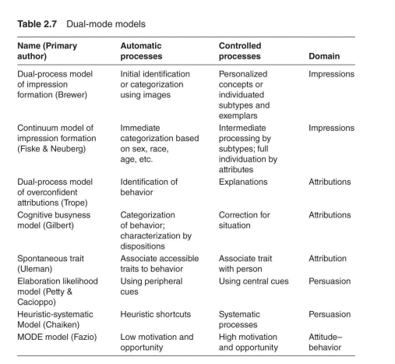
Models Describe the How and When of Automatic and Controlled Processes

Slide 28
Impression Formation and Person Perception
Dual-process model of impression formation People initially identify a person automatically, then they stop there if the person is not relevant to their goals.
Continuum model of impression formation One can specify both information configurations and motivations that move people from one end of the continuum to another.

Slide 29
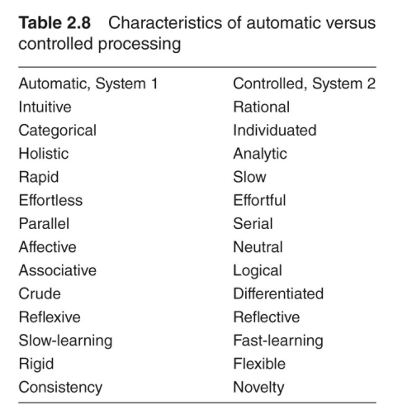
Automaticity-Control in Other Areas: Self, Prejudice, Inference

Slide 30
The Dissent: Single-Mode Alternatives
The unimode model builds on a lay epistemic （世俗认知）theory of ordinary knowledge. This proposes that people’s subjective understanding essentially tests their everyday hypotheses. If fatigued, drink coffee; if in love, get married.
Another single-mode alternative argues that impression formation operates via parallel processes, blending all attributes simultaneously activated.

Slide 31
Summary
People’s thought processes can operate on automatic or in control, or somewhere between the two.
Various motivations determine whether people engage relatively automatic or controlled processes. Each motive can push toward either automaticity or control, depending on circumstances.
Dual-mode models appear in person perception, attribution, attitudes, self, inference, and prejudice, to name a few.
Single-mode alternatives argue for similar processes, regardless of information and motivation.

Slide 32
Thank you!

